Slide 1
Session 07
Package, Exceptions and Assertions
(http://docs.oracle.com/javase/tutorial/essential/exceptions/index.html)
Session 07 - Package and Exception handling
Notes:
A software is usually organized as a folder. A folder containing java classes is call as a package but this folder must be created by the Java complier.
We all experience about unpleasant feeling when facing errors or exceptions caused by a software. Now you are programmers, you surely do not want your programs existing errors implicitly.

Slide 2
Objectives
Packages
Exception Handling
  try block
  catch block
  finally block
  custom exception class
Assertions
Session 07 - Package and Exception handling

Slide 3
Packages
A package is a grouping of related classes, interfaces, enumerations, and annotation types providing access protection and name space (set of pre-defined names) management.
Syntax to create a new package:
  package [package name];
  This statement must be the first line in the source file.
  There can be only one package statement in each source file, and it applies to all types in the file.
  The compiler will read source code line-by-line from the beginning of the source file. So, the first work must be carried out is creating the folder and the folder name is the package name. The package information will be added to classes in this package.
Session 07 - Package and Exception handling

Slide 4
Using Packages Members
To use a public package member from outside its package, we can:
  Refer to the member by its fully qualified name
  graphics.Rectangle myRect = new graphics.Rectangle();
  Import the package member
    import graphics.Rectangle;
    …
    Rectangle myRectangle = new Rectangle();
  Import the member's entire package
    import graphics.*;
    …
    Rectangle myRectangle = new Rectangle();
2 packages can contain 2 classes which have the same name
pkg1.ClassA obj1;
pkg2.ClassA obj2;
Session 07 - Package and Exception handling

Slide 5
Exceptions
When a program is executing something occurs that is not quite normal from the point of view of the goal at hand.
For example:
  a user might type an invalid filename;
  a file might contain corrupted data;
  a network link could fail;
  …
Circumstances of this type are called exception conditions in Java and are represented using objects (All exceptions descend from the java.lang.Throwable).
D:\PhanHa\FPT\Gui Ha & Van Anh\PRO192\PRO192-materials (for students)\02-examples\02-exceptions\6-why user need to throw Exception
JAD Session 3 - Flow Control,
Assertions, and
Exception Handling
<number>/33
Notes:
Circumstances: Tình huống
corrupted : hỏng

Slide 6
public class HelloException {
public static void main(String[] args) {
System.out.println("Three");
int value = 10 / 2;
System.out.println("Two");
value = 10 / 1;
System.out.println("One");
// exception
value = 10 / 0;
// the code is not run.
System.out.println("Let's go!");
}
}
Session 07 - Package and Exception handling

Slide 7
public class HelloCatchException {
public static void main(String[] args) {
System.out.println("Three");
int value = 10 / 2;
System.out.println("Two");
value = 10 / 1;
System.out.println("One");
try {
value = 10 / 0;
// the code is not run.
System.out.println("Value =" + value);
} catch (ArithmeticException e) {
System.out.println("Error: " + e.getMessage());
System.out.println("Ignore...");
}
// the code is run
System.out.println("Let's go!");
}
}
Session 07 - Package and Exception handling

Slide 8
Catching Exceptions
try {
// Exception-throwing code
}
catch (Exception_type name) {
// Exception-handling code
}
D:\PhanHa\FPT\Gui Ha & Van Anh\PRO192\PRO192-materials (for students)\02-examples\02-exceptions\1-Exception class\1
JAD Session 3 - Flow Control,
Assertions, and
Exception Handling
<number>/33

Slide 9
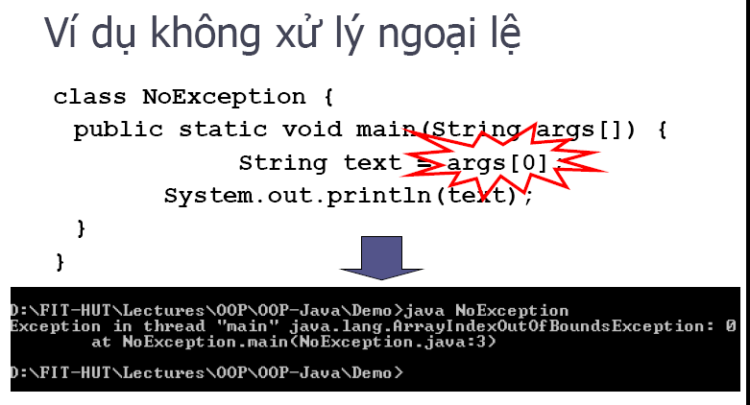
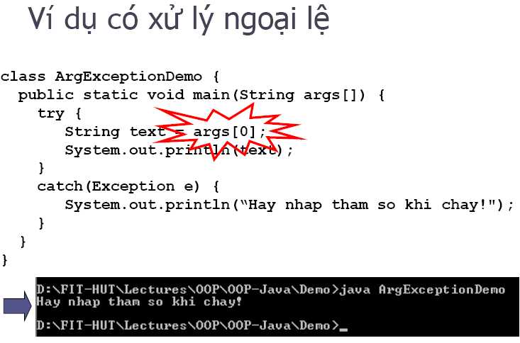
06/2014
- Ngoại lệ-TS.

Slide 10
Multiple catch blocks
try block may contain code that throws different exception types. This can even happen if the block contains only a single line of code, because a method is allowed to throw different types to indicate different kinds of trouble.
JAD Session 3 - Flow Control,
Assertions, and
Exception Handling
<number>/33

Slide 11
Multiple catch blocks..
File myFile = getMyFile();
String s = getStringAndHopeForAllDigits();
try {
System.out.println("About to call.");
int x = Integer.parseInt(s);
myFile.getCanonicalFile();
System.out.println("Call succeeded.");
}
catch (NumberFormatException xceptn) {
System.out.println("Bad text! " + xceptn.xceptn.printStackTrace();
}
catch (IOException xceptn) {
System.out.println("File stress! " + xceptn.printStackTrace();
}
System.out.println("Life goes on.");
JAD Session 3 - Flow Control,
Assertions, and
Exception Handling
<number>/33

Slide 12
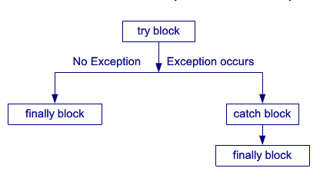
The finally Block
The last catch block associated with a try block may be followed by a finally block.
The finally block’s code is guaranteed to execute in nearly all circumstances excepts:
  The death of the current thread
  Execution of System.exit()
  Turning off the computer
  D:\PhanHa\FPT\Gui Ha & Van Anh\PRO192\PRO192-materials (for students)\02-examples\02-exceptions\5-Error
JAD Session 3 - Flow Control,
Assertions, and
Exception Handling
<number>/33

Slide 13
File myFile = getMyFile();
String s = getStringAndHopeForAllDigits();
try {
System.out.println("About to call.");
int x = Integer.parseInt(s);
myFile.getCanonicalFile();
System.out.println("Call succeeded.");
}
catch (NumberFormatException xceptn) {
System.out.println("Bad text! " + xceptn.xceptn.printStackTrace();
}
catch (IOException xceptn) {
System.out.println("File stress! " + xceptn.printStackTrace();
}
finally {
System.out.println("In the finally block.");
}
System.out.println("Life goes on.");
JAD Session 3 - Flow Control,
Assertions, and
Exception Handling
<number>/33

Slide 14
Declaring Exceptions
There is a way to call exception-throwing methods without enclosing the calls in try blocks. A method declaration may end with the throws keyword, followed by an exception type, or by multiple exception types followed by commas.
private int throwsTwo() throws IOException, AWTException
{…}
Of course, methods that call throwsOne() or throwsTwo() must either enclose those calls in try blocks or declare that they, too, throw the exception types.
Examp: Project Method_thowException
JAD Session 3 - Flow Control,
Assertions, and
Exception Handling
<number>/33

Slide 15
Two Kinds of Exception
Checked exception
  Must be handled by either the try-catch mechanism or the throws-declaration mechanism.
Runtime exception
  The right time to deal with runtime exceptions is when you’re designing, developing, and debugging your code. Since runtime exceptions should never be thrown in finished code.
There is some difference there for checked and unchecked Exception
Suppose checked exception means it shows the compile time exception
ex: NoSuchMethod exception, NoSuch Field Exception , ClassNot Found Exception
where as in Unchecked Exception shows Runtime Only
ex: Nullpointer Exception, Number Format Exception
Checked exceptions should always be caught
Runtime exceptions don’t have to be caught.
Errors should never be caught.
The stack trace is recorded when the exception is constructed.
It is never appropriate for application programmers to construct and throw errors.
JAD Session 3 - Flow Control,
Assertions, and
Exception Handling
<number>/33
Notes:
Handled: Xử lý

Slide 16
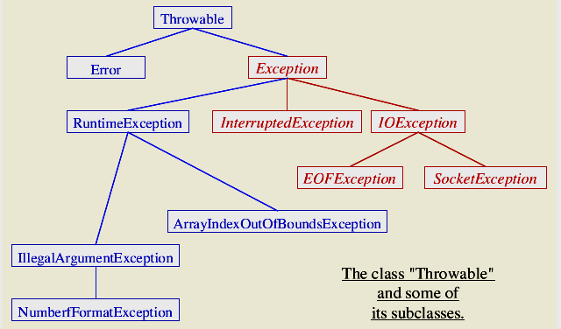
The Exception Inheritance Hierarchy
Checked Exceptions
JAD Session 3 - Flow Control,
Assertions, and
Exception Handling
<number>/33

Slide 17
Some runtime (unchecked) exceptions
The types of exceptions that need not be included in a methods throws list are called Unchecked Exceptions. They can be foreseen and prevented by a programmer and, generally speaking, will never occur in a high-quality program:
ArithmeticException
ArrayIndexOutOfBoundsException
ClassCastException
IndexOutOfBoundsException
IllegalStateException
NullPointerException
SecurityException
D:\PhanHa\FPT\Gui Ha & Van Anh\PRO192\PRO192-materials (for students)\02-examples\02-exceptions\3-runtime exceptions
JAD Session 3 - Flow Control,
Assertions, and
Exception Handling
<number>/33

Slide 18
Some checked exceptions
The types of exceptions that must be included in a methods throws list if that method can generate one of these exceptions and does not handle it itself are called Checked Exceptions. Checked exceptions can happen at any time, cannot be prevented and therefore the language enforces to deal with them.
ClassNotFoundException
CloneNotSupportedException
IllegalAccessException
InstantiationException
InterruptedException
NoSuchFieldException
NoSuchMethodException
D:\PhanHa\FPT\Gui Ha & Van Anh\PRO192\PRO192-materials (for students)\02-examples\02-exceptions\3-runtime exceptions\other
JAD Session 3 - Flow Control,
Assertions, and
Exception Handling
<number>/33

Slide 19
Throwing Exceptions
The methods that you write can throw exceptions.
To throw your own exception, first decide whether the exception should be checked at runtime. Then choose the appropriate exception type.
If you find a class whose name describes the situation you want to signal, use that class. If you don’t, you’ll have to create your own exception class.
For example:
IOException x = new IOException("Phaser bank lockup.");
throw x;
All checked exception types thrown from a method must be represented in the method’s “throws” list.
JAD Session 3 - Flow Control,
Assertions, and
Exception Handling
<number>/33

Slide 20
Creating Your Own Exception Classes
Decide whether you want a checked or a runtime exception.
  Checked exceptions should extend java.lang.Exception or one of its subclasses.
  Runtime exceptions should extend java.lang.RuntimeException or one of its subclasses
JAD Session 3 - Flow Control,
Assertions, and
Exception Handling
<number>/33

Slide 21
Creating Your Own Exception Classes…
The argument list of these constructors should include
  A message
  A cause
  A message and a cause
JAD Session 3 - Flow Control,
Assertions, and
Exception Handling
<number>/33

Slide 22
Exception Occurrence
class ThrowStatement extends Exception {
public static void exp(int ptr) {
if (ptr == 0)
throw new NullPointerException();
}
public static void main(String[] args) {
int i = 0;
ThrowStatement.exp(i);
}
}
java.lang.NullPointerException
at ThrowStatement.exp(ThrowStatement.java:4)
at ThrowStatement.main(ThrowStatement.java:8)
JAD Session 3 - Flow Control,
Assertions, and
Exception Handling
<number>/33

Slide 23
Exceptions and Overriding (1)
When you extend a class and override a method, the Java compiler insists that all exception classes thrown by the new method must be the same as, or subclasses of, the exception classes thrown by the original method. In other words, an overriden method in a sub class must not throw Exceptions not thrown in the base class. Thus if the overriding method does not throw exceptions, the program will compile without complain.
JAD Session 3 - Flow Control,
Assertions, and
Exception Handling
<number>/33
Notes:
Insists: Khẳng định

Slide 24
Exceptions and Overriding (2)
// correct overriding examples:
class A
{float thu(int x, int y) throws Exception {return(0);}
}
class B extends A
{float thu(int x, int y) throws IOException {return(0);}
}
class A
{float thu(int x, int y) throws Exception {return(0);}
}
class B extends A
{float thu(int x, int y) {return(0);}
}
JAD Session 3 - Flow Control,
Assertions, and
Exception Handling
<number>/33

Slide 25
Exception Propagations
catch(...)
A()
B()
Stack for A()
Stack for B()
C()
Stack for C()
D()
Exception
Stack for D()
Stack trace
When an exception occurs at a method, program stack is containing running methods ( method A calls method B,….). So, we can trace statements related to this exception.
Notes:
Propagations: Sự lan truyền

Slide 26
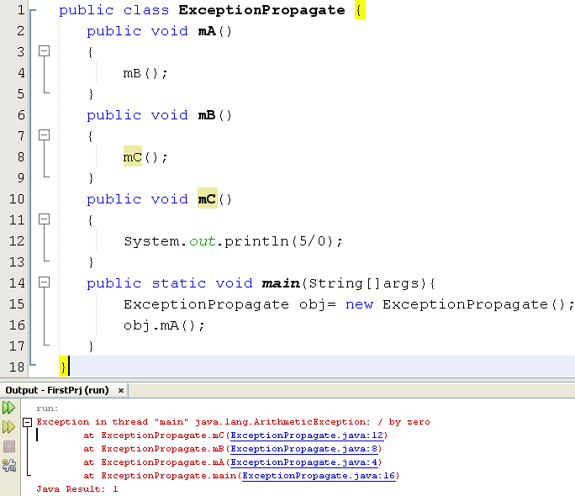
Exception Propagations
Session 07 - Package and Exception handling

Slide 27
Nesting of try/catch Blocks
A try statement may be nested inside either the try or catch block of another try statement.
try {
// Pseudo code.
open a user-specified file
}
catch (FileNotFoundException e) {
try {
// Pseudo code.
open a DEFAULT file instead ...
}
catch (FileNotFoundException e2) {
// Pseudo code.
attempt to recover ...
}
}
Session 07 - Package and Exception handling

Slide 28
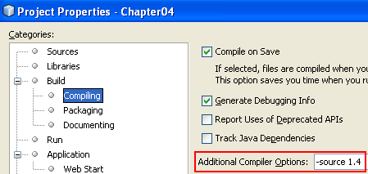
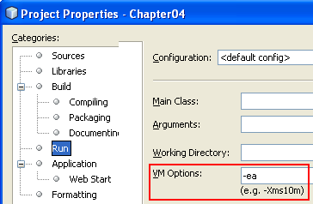
Assertions
Assertions are introduced in Java 1.4
2 Ways of writing assertion statements:
  assert expression; // true-false condition true: do smt
  falese: not do
  assert expression1:expression2; //
  condiontion:ExceptionMessage
You must specify options when the program is compiled and run.
We can replace an assertion with an if statement.
In Java from 1.5, the keyword assert is removed?
D:\PhanHa\FPT\Gui Ha & Van Anh\PRO192\PRO192-materials (for students)\02-examples\03-assertion
Notes:
Assertions: Xác thực
assertion để mô tả cách thức các đoạn code hoạt động như thế nào, chứng thực các ràng buộc bên trong hệ thống.

Slide 29
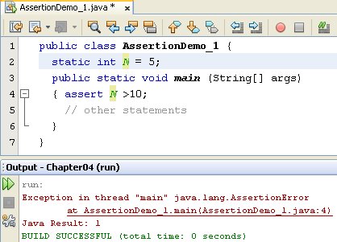
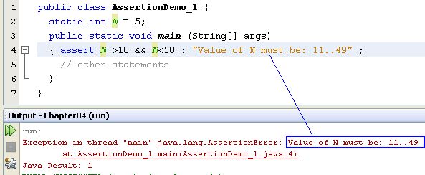
Assertions…

Slide 30
Assertions and Compilation
1.4 compiler
javac -source 1.4 UsefulApplication.java
  (If the flag was omitted, the 1.4 compiler treated source code as if the assert keyword did not exist; thus assert could be used as an identifier.)
1.5 compiler
no longer necessary to compile with a -source flag
JAD Session 3 - Flow Control,
Assertions, and
Exception Handling
<number>/33
Notes:
Assertions: Xác nhận

Slide 31
Runtime Enabling of Assertions
Assertions are disabled by default. To enable assertions at runtime, use the
-enableassertions or -ea flag on the Java command line, as in the following example:
  java -ea UsefulApplication
  java - enableassertions UsefulApplication
JAD Session 3 - Flow Control,
Assertions, and
Exception Handling
<number>/33
Notes:
Disabled: Cấm sử dụng

Slide 32
Using Assertions
Assertions are commonly used to check:
  preconditions,
  postconditions, and
  class invariants
JAD Session 3 - Flow Control,
Assertions, and
Exception Handling
<number>/33
Notes:
Postcondition: Điều kiện sau
preconditions,: Đk truwocs
invariants
invariants
invariants
: Bất biến

Slide 33
Precondition
A precondition is a constraint that must be met on entry of a method.
If a method’s preconditions are not met, the method should terminate at once before it can do any damage.
JAD Session 3 - Flow Control,
Assertions, and
Exception Handling
<number>/33
Notes:
Constraint: Hạn chế
Met: đáp ứng

Slide 34
Postcondition
A postcondition is a constraint that must be met on return from a method. If a method’s postconditions are not met, the method should not be allowed to return.
JAD Session 3 - Flow Control,
Assertions, and
Exception Handling
<number>/33

Slide 35
Class invariant
A class invariant is a constraint on a class’s state that must be met before and after execution of any non-private method of a class.
JAD Session 3 - Flow Control,
Assertions, and
Exception Handling
<number>/33

Slide 36
Using Assertions Sample
private Book reserveACopy(String title, Member member) {
assert isValidTitle(title);
Book book = getAvailableCopy(title);
reserve(book, member);
assert bookIsInStock(book);
return book;
}
JAD Session 3 - Flow Control,
Assertions, and
Exception Handling
<number>/33

Slide 37
Summary
Packages
Exception Handling
Multiple Handlers
Code Finalization and Cleaning Up (finally block)
Custom Exception Classes
Assertions
Session 07 - Package and Exception handling

